Slide 1
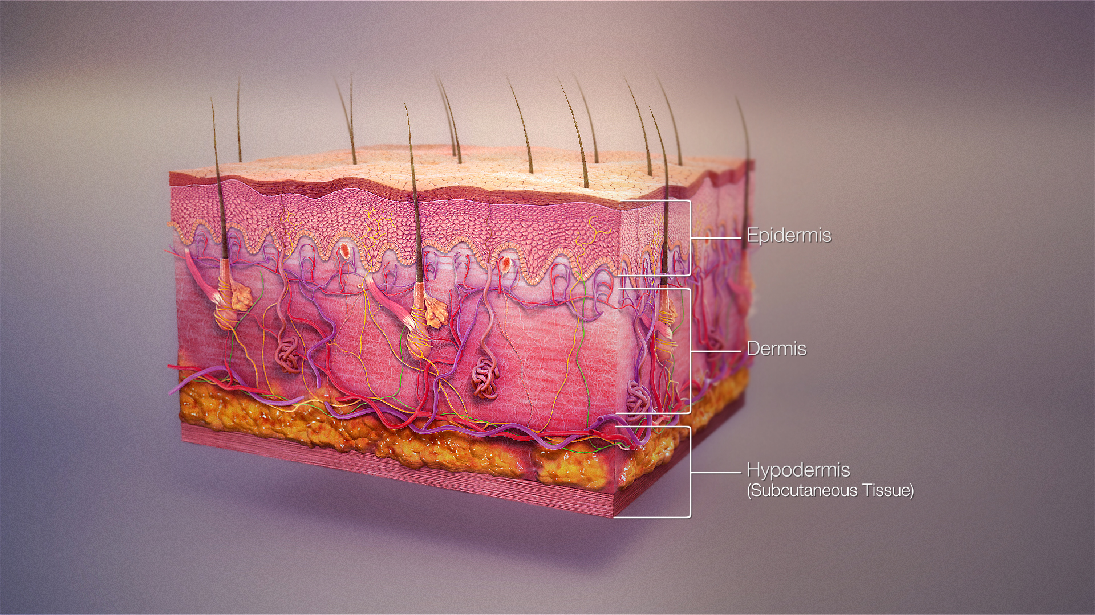
Skin app

Slide 2
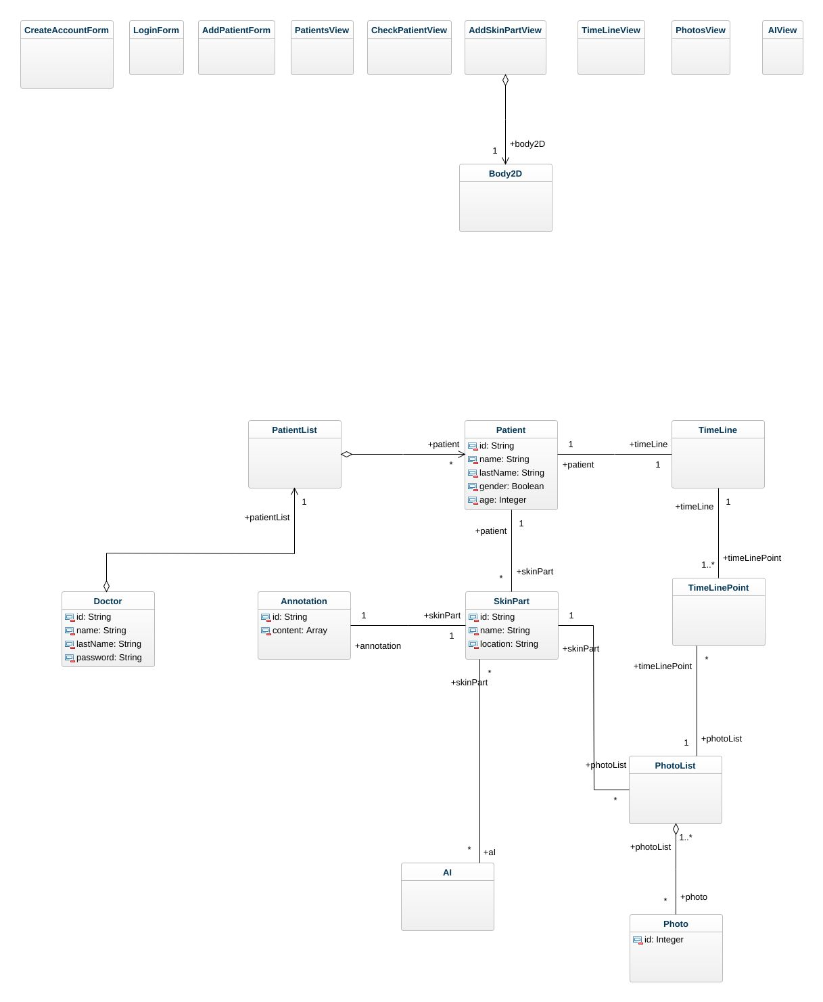
Class diagram

Slide 3
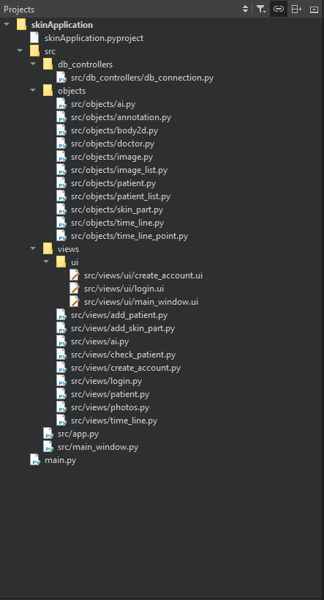
Project files structure

Slide 4
Create account
Name
Last name
Password
Repeat password
Email
Create
Notes:
Account creation for doctors

Slide 5
Login
Name
Agustin CARTAYA
Password
*****
Forgot password
Login
Notes:
Login for doctors

Slide 6

List of patients
Add new patient
ID: 34AD
Organizer
Filters
A-z
Z-A
ID
Name
CLINICAL ATTRIBUTES
Gender
ID: 34AD
ID: 27AD
ID: 3444
ID: 34AO
M
F
Age
Precise
Ej: 36
Rangue
ID: 34BD
ID: 87D6
ID: 348D
ID: 34P4
0-20
20-50
50+
DIAGNOSTIC ATTRIBUTES
Bening (120/300)
Malignant (150/300)
1
Of 300
Indeterminate (30/300)

Slide 7
Add patient
Name
Last name
Age
Gender
M
F
Create

Slide 8
Check patient
Export patient data
Patient ID: 34AD
Parts of the skin under study
Patient ID: 34AD
Name: | Agustin
Last Name: | CARTAYA
Gender | Male
Age | 21
Add
Medical information
Notes:
More oprions: export data in PDF
AI Results: Will show the IA with the more accurate result

Slide 9


Check patient
Export patient data
Patient ID: 34AD
Patient ID: 34AD
Parts of the skin under study
Name: | Agustin
Last Name: | CARTAYA
Gender | Male
Age | 21
Annotations
Risk: BENIGN
Type: Mole
Notes: ….
Read more
AI Results
Type IA: IA - 1
Risk: BENIGN
Type: Mole
Accurance: 93%
See other IA results
See Timeline
See Images
Ear
More options
Update
Annotations
Risk: MALIGNANT
Type: Melanoma
Notes: ….
Read more
AI Results
Type IA: IA - 3
Risk: MALIGNANT
Type: Melanoma
Accurance: 87%
See other IA results
See Timeline
See Images
Back
More options
Medical information
Update
Add
Notes:
More oprions: export data in PDF
AI Results: Will show the IA with the more accurate result

Slide 10






Add skin lesion
Completed
Caracteristics
Add images
Diameter | 2mm
Apparition | 3 weeks ago
Add.. | …
2
5
48
Other
Launch AI
AI-1
AI-2
AI-3
AI-4
Description
……
….
………
Results
Risk: MALIGNANT
Type: Melanoma
Accurance: 87%
Description
……
….
………
Description
……
….
………
l
+
Notes:
When you select one of the numbe below one of the add image icon, you can modify the images selected
The skin lesion and the images will be saved either when the doctor click on « Complet » or when he tries to use an AI

Slide 11
Time line
Location: Ear | Patient ID: 34AD | Name: Agustin | Last name: CARTAYA
27 - 04 - 2013
27 - 04 - 2013
27 - 04 - 2013
27 - 04 - 2013
27 - 04 - 2013
Annotations
Medecin: François DUPONT
Risk: BENIGN
Type: Mole
Notes: ….
Read more
AI Results
Type IA: IA – 1 Risk: BENIGN Type: Mole Accurance: 84% Read more | Type IA: IA – 2 Risk: BENIGN Type: Mole Accurance: 91% Read more | Type IA: IA – 3 Risk: BENIGN Type: Mole Accurance: 93% Read more
Images
Photos
Dermatoscope
Microscopy

Slide 12
Photos
Organizer
Date
Name
A-z
Z-A
IMG 1
IMG 1
IMG 1
IMG 1
IMG 1
Filters
Type
Photo (120/300)
Dermatology (150/300)
Microscopy (30/300)
IMG 1
IMG 1
IMG 1
IMG 1
IMG 1
Description
Type: Microscopy
Name: PH-01
Date: 27 - 04 – 2021
Depth: 22.2 mm
IMG 1
IMG 1
IMG 1
IMG 1
IMG 1
1
Of 300

Slide 13


AI - 1
Learn more
Information required
Patient
Skin lesion
Eye color
Hair color
Diameter
Color
Images required
Name image | Min required | Max | Selected
Dermatoscopy | 2 | 4 | 1
Microscopy | 5 | 10 | 3
Medical image | 0 | 1 | 0
Other | 1 | 1 | 0
Calculate

